Slide 1
From: Bill and Ted’s Excellent Adventure
Ox: [Delivering a history report] Everything is different, but the same... things are more moderner than before... bigger, and yet smaller... it's computers... ...SAN DIMAS HIGH SCHOOL FOOTBALL RULES!

Slide 2
Introduction
CS 3339
Lecture 1
Greg LaKomski
Texas State University
Fall 2018

Slide 3
This is CS3339 – Computer Architecture. If you are surprised by this you are probably not supposed to be here !

Slide 4
Instructor Info
Greg LaKomski
Comal 210 B
greg@txstate.edu
Office Hours: Mon 11:30 – 1:45
Wed 11:30 – 1:45
(… or whenever my door is open)
I disconnected my office phone since it was interfering with my coffee maker.
Notes:
Visit web page

Slide 5
Communication
I use TRACS
I send emails – frequently – when I want you all to know something.
You must check your email!
I frequently assign things verbally or change dates verbally in class.
I will be in my office on Mondays and Wednesdays from 11:30 til I leave to walk to class. Happy to talk to you then.
If this will not work I will be happy to call you and we can talk on the phone. I know – TALK! – yes TALK!. My thumbs are too fat and they are not as fast as yours.

Slide 6
Communication
Bottom Line – Direct from the Student Ombudsman
You are responsible for understanding what the requirements are for this class. I will explain them and they are on TRACS.
Please do not “lawyer me”. You are also responsible for having common sense. I cannot spell out every eventuality but you are required to do what a reasonable student would do!

Slide 7
Late Policy
If your homework is late I won’t grade it. Period.
The projects are expected to be completed and submitted to me by the due dates. If I know your close I am highly flexible. If you have screwed around I am not.

Slide 8
Academic Honesty
Need to be very careful, especially in CS
Plagiarism of ‘code’
Collusion
Do NOT present others work as yours
Team work
Work in pairs for the projects - We will talk about this more later
This is actually easy for me to figure out. Test questions where the only way to answer is to have coded are not hard for me to come up with.
Notes:
Choosing partners

Slide 9
Academic Honesty
Do NOT cheat!
If I catch you cheating I will not be happy and I will utilize all options open to me to let you know just how unhappy I am.
http://www.txstate.edu/honorcodecouncil/Academic-Integrity.html.
Notes:
Choosing partners

Slide 10
Respect
Everyone is paying to be here and should expect an environment that is conducive to learning!
Please show respect for your fellow students.
Please show me your respect.
If your behavior, demeanor, clothing, or anything else is disrupting the class you will be asked to leave. That simple. I have no problem calling the campus cops if needed for everyone to feel safe.
That said, appropriate discussion is encouraged !

Slide 11
Phones and Computers
If you bother me or your fellow students with either I will have you stow them.
I do NOT WANT TO HEAR THEM MAKE ANY SOUNDS!
To be honest, I don’t like it when you are looking at your email or cat videos while I am talking. Its really disrespectful, but along with not taking responsibility for bad behavior and tweeting ignorant comments all the time it has become a norm.

Slide 12
Overview
You are all either Juniors or Seniors and I have very high expectations of you. It is your responsibility to learn the material NOT mine to make you learn the material.
This material is not inherently difficult but it is very different from other classes you have taken and so it requires additional study and focus.
We are going to use an ebook for this class and you are all REQUIRED to have access to it. There are no exceptions to this.
We are going to be using the ARMv8 architecture instead of MIPS. Do you remember the DEC corporation? No? Immensely important in its time but no one studies PDP architecture. Same with MIPS. Fugettaboutit.

Slide 13
Overview
Your grade in this class will be composite of homework scores, points for working through the ebook material, test scores, and successful completion of three team coding projects as described in my email to you.
At last count there was 61 people in this section so although my preference is teams of two there will be one and only one team of three. I will expect everyone to shoulder their share of the work on the projects and just as in a real job if this isn’t happening I expect to hear about it sooner than later and I will take corrective action.
More on this later.

Slide 14
Evaluation
Homework 10%
On line exercises 7%
Projects 21%
Exam 1 21%
Exam 2 21%
Final 20%
Projects
Part 1 4%
Part 2 9%
Part 3 8%

Slide 15
Coding
Will be using Python 2.7
Install jetBrains PyCharm please.
Use the debugger!
I will do a short lecture on this soon.

Slide 16
Communication
I am frequently on line at night and if I get emails I will answer them if possible.
As the semester progresses I often find that I am spending a lot of time helping you debug your code. That’s perfectly fine and I am happy to do it as long as you have tried. If you have coding issues lets talk. Do not wait until its due! Think of it like a real job.

Slide 17
Course Goals
Understand the organization of hardware components
Understand the interactions of hardware and software
Understand the interactions of “software” at various levels
Be able to measure and evaluate systems

Slide 18
My Goals
Of course I would like you to master the material.
I want you to have the experience of learning a language you might not know well or at all and apply it to a reasonably complex project in a compressed time frame. This is exactly what will happen to many of you on your first job.
I want you to be able to put these projects on your resumes because they are worthy of it as you shall see. I want you to put ARM experience on your resume.
I would like you all to be challenged and have fun.
I really want you all to get great jobs and be completely successful and hire more Texas State Grads ☺

Slide 19
Attendance
You need to be here since I will be expanding on the material in the ebook not just repeating it.
That said, if you don’t want to come to class its your funeral.
I will be taking attendance via the TRACS app every session. No credit but if your grade is close I will absolutely factor it in.
I frequently make changes and announcements at the start of class. If you were not here to hear and miss something, well, too bad.

Slide 20
Schedule
Posted on TRACS
Will undergo some revision based on facts on the ground
I will try NOT to change test dates unless absolutely required

Slide 21
Syllabus
Posted on TRACS. Summarizes everthing I just said. It is subject to change as is the schedule.

Slide 22
Questions?

Slide 23
ENGAGE BRAIN PLEASE!
Lets Get Started

Slide 24
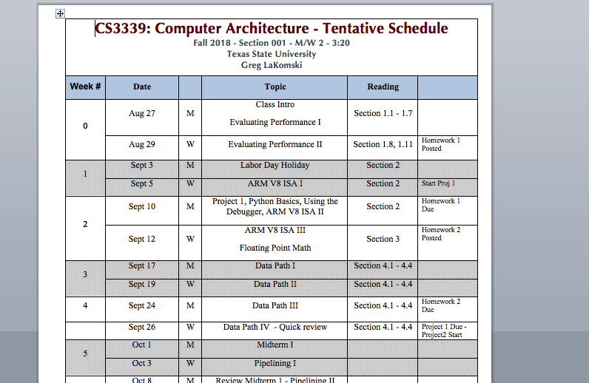

Slide 25
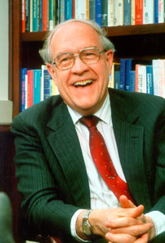
What Is Computer Architecture?
Computer architecture is the conceptual design and
fundamental operational structure of a computer system
- wikipedia
Computer architecture, like other architecture, is the art of determining the needs of the user of a structure and then designing to meet those needs as effectively as possible within economic and technological constraints
- Fred Brooks – IBM , Turing Award 1999

Slide 26
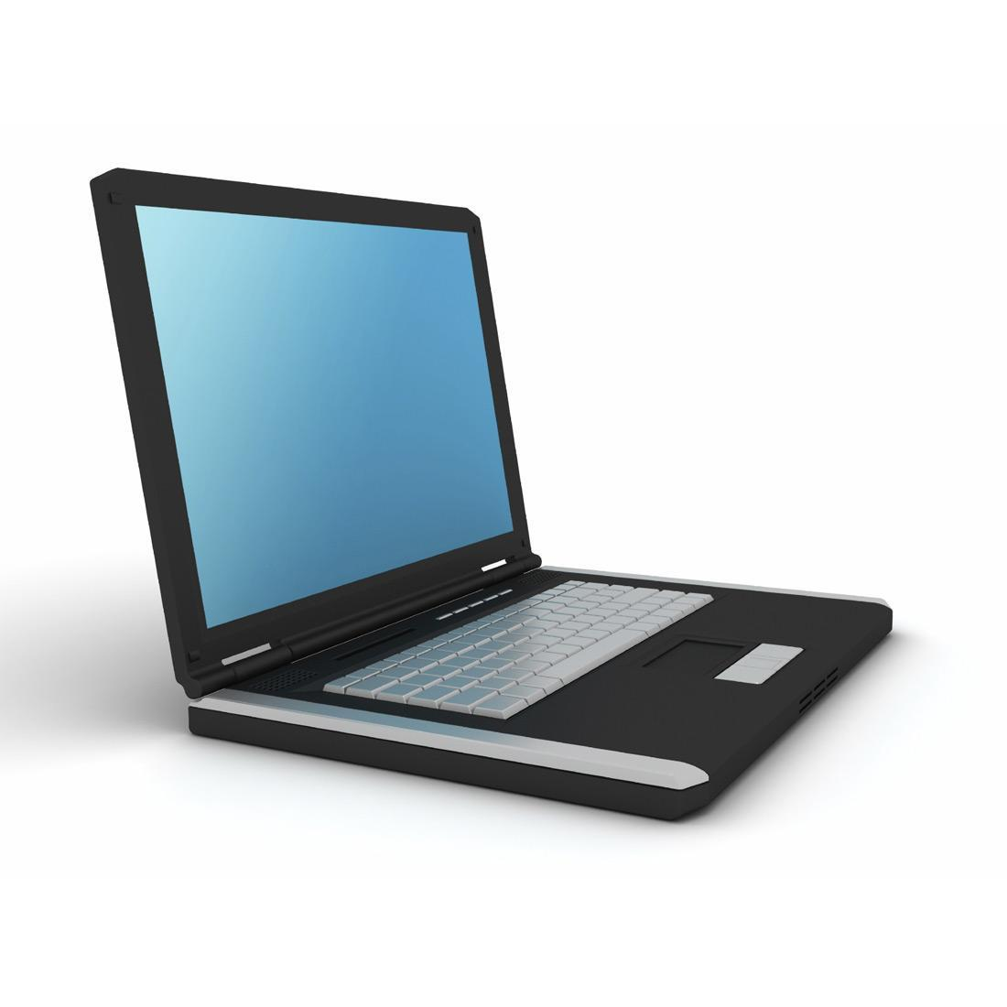
What is Computer Architecture?
Problem
Use Computer to Solve Problem
Lots of things going on
- correctly
- efficiently
- securely

Slide 27
Abstraction Layers in Modern Systems
Application
Problem
Algorithm
Programming Language
Operating System/Compilers
Instruction Set Architecture (ISA)
Domain of computer architecture
Microarchitecture
Gates/RTL
Circuits/Devices
Physics

Slide 28
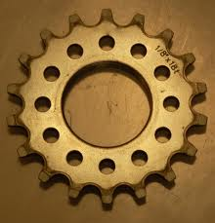
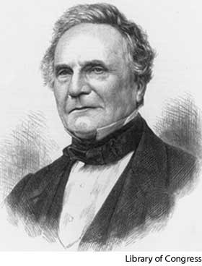
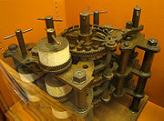
Phase I : Mechanical Gears
Charles Babbage (1791-1871)
Difference Engine
Analytical Engine
Never built!
Based on the idea of the mechanical loom
Successors
Mark I @ Harvard
Linear Equation Solver @ Iowa State
Main architectural issue
Not a lot
Abstraction layers yet to materialize
Computation hardwired
One man show

Slide 29
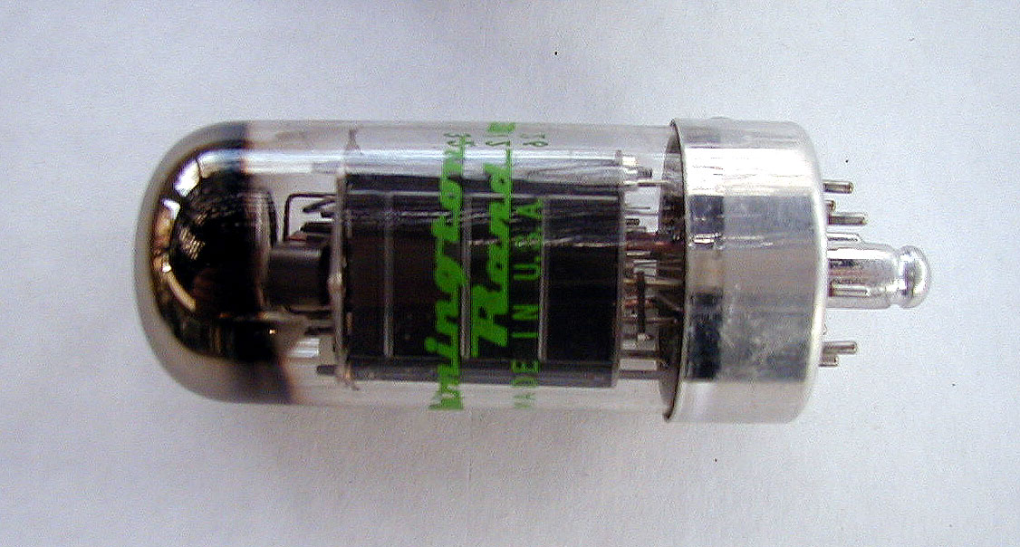
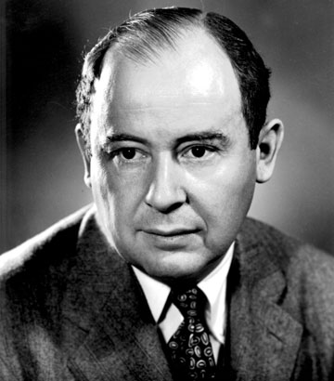
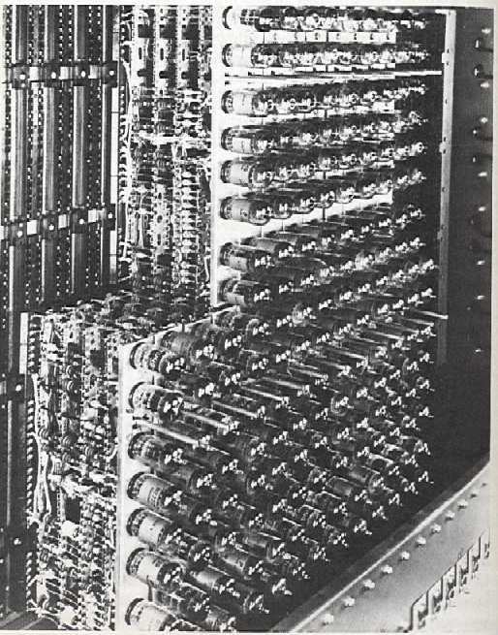
Phase II : Vacuum Tubes
ENIAC
First electronic computer
Eckert, Mauchly @ Upenn
Backed by DoD
EDVAC
Von Neumann
Modern architecture named after him
EDSAC
Read-write memory
Main Architectural Issue:
Storage
Space
Reliability
Tubes and memory technology
Heat, power

Slide 30
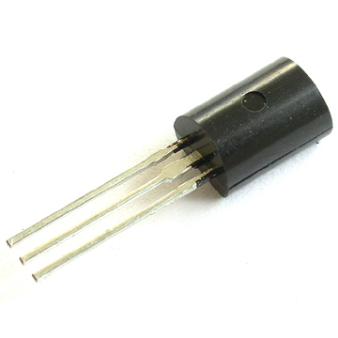
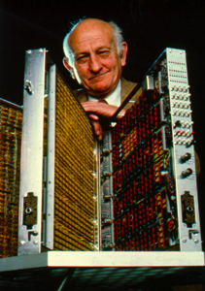
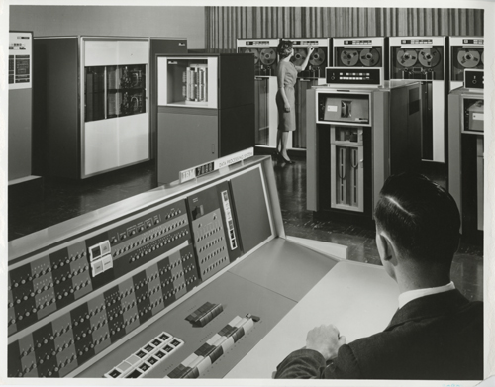
Phase III : Transistors
Mid 50s – Mid 60s
IBM joins the game
Transistors small and low-power
Increased reliability
Introduction of high-level languages
Main architectural issue
Focus on ISA
machines getting more complex
need to hide complexity from programmer
Memory

Slide 31
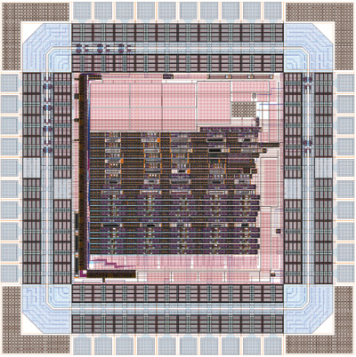
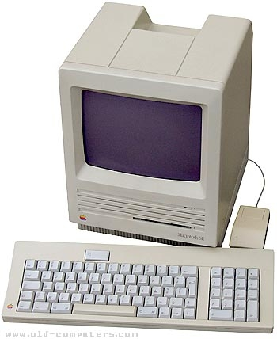





Phase IV : Integrated Circuits and VLSI
Mid 60s – 2000s
Cram thousands – then millions – then billions of transistors onto a single chip
Both Kilby and Noyce credited
Semiconductor memory
Parallel Architectures
Main architectural issues
Memory capacity and speed
Cache, VM
Extensive ISAs
ILP : functional units, pipelining

Slide 32
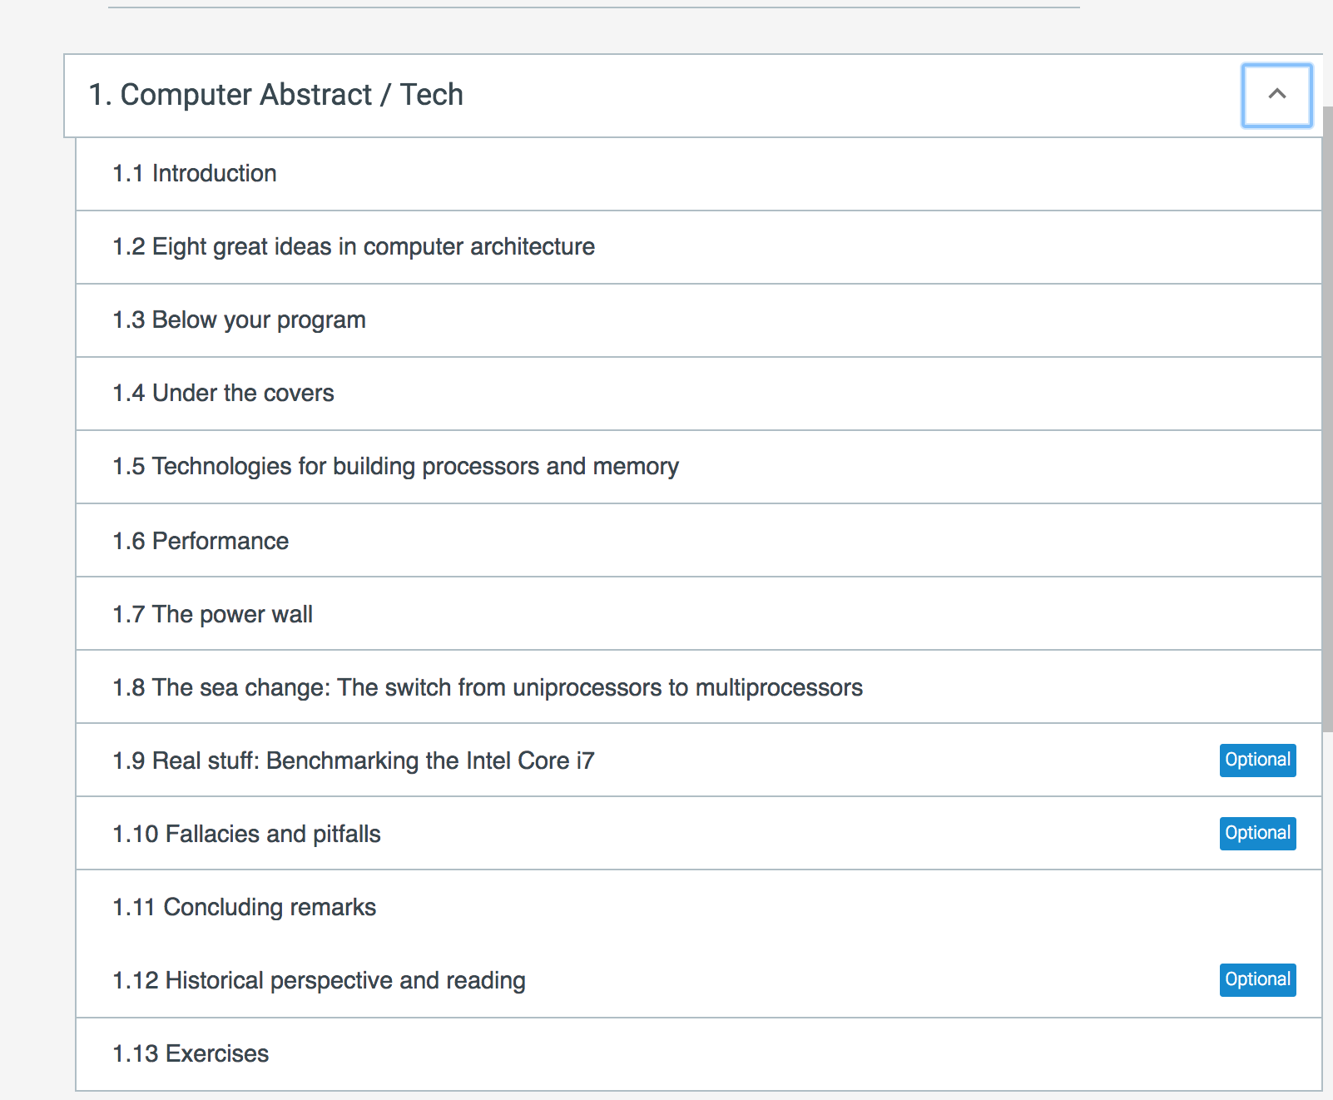
Chapter 1

Slide 33
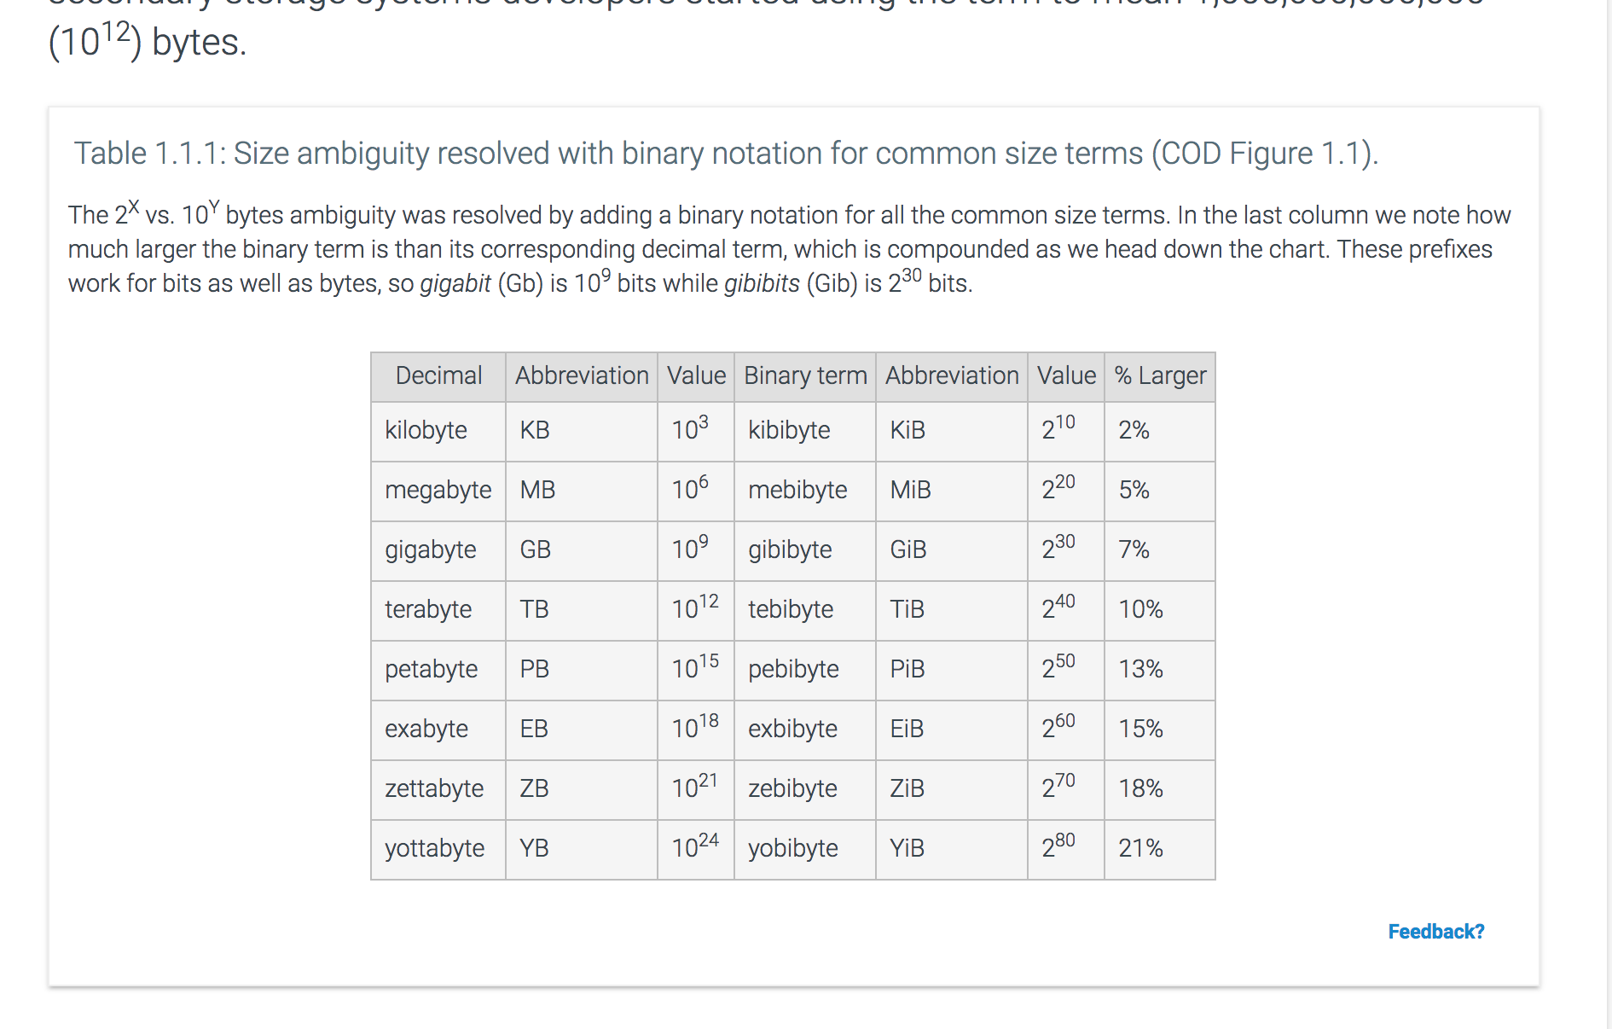
Size is Important
Add slides covering sections

Slide 34
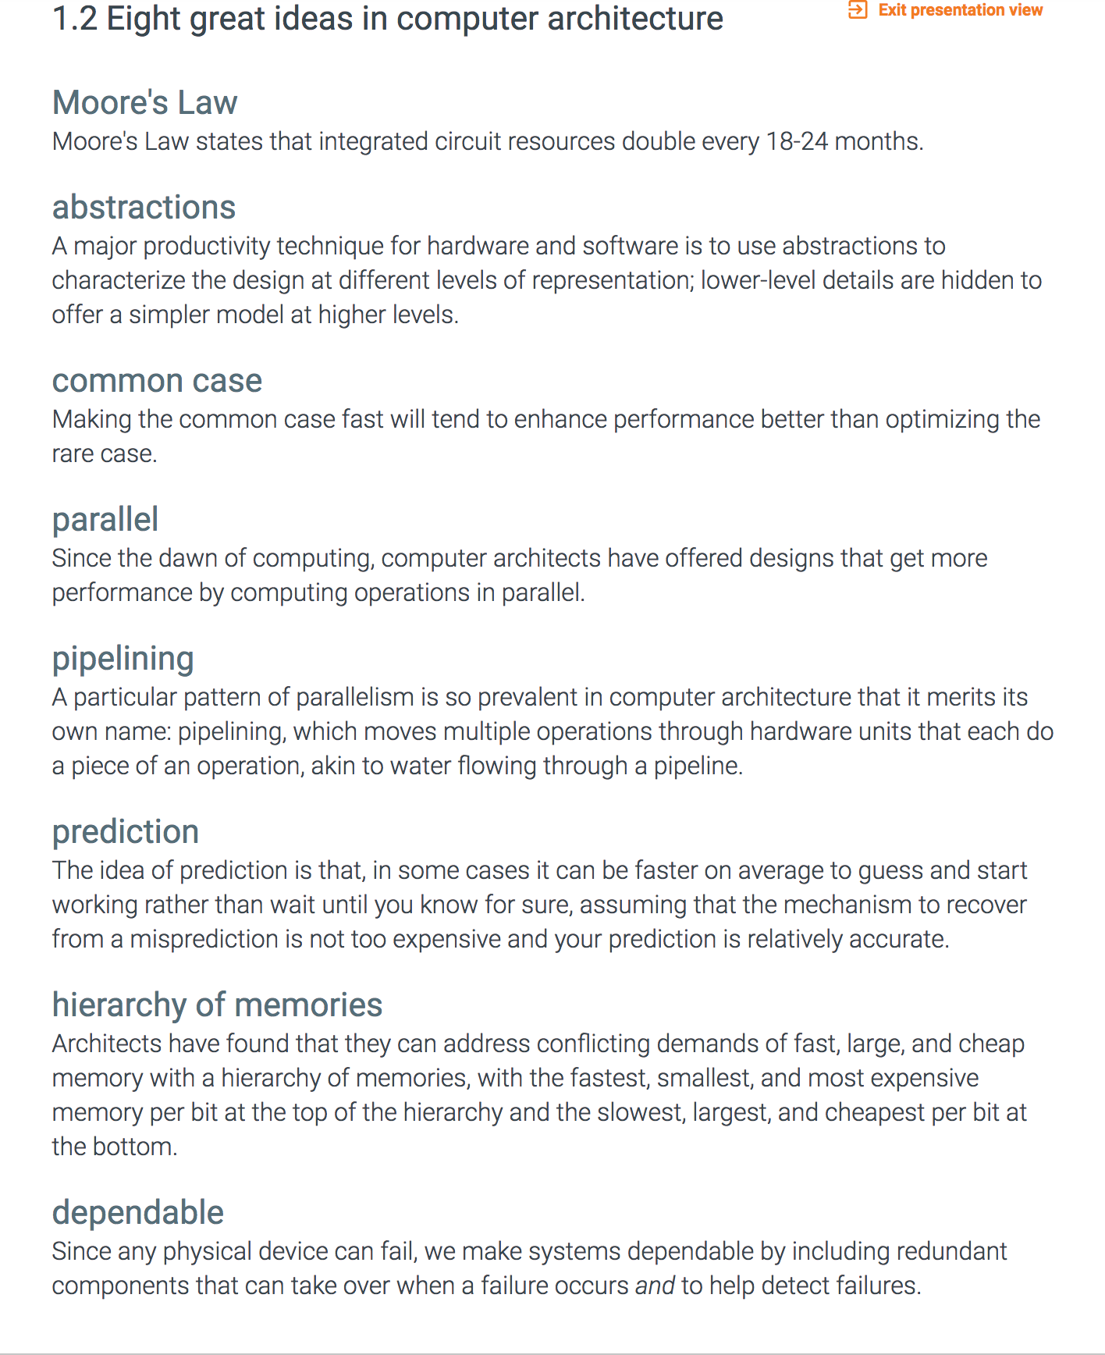
Eight Great Ideas

Slide 35
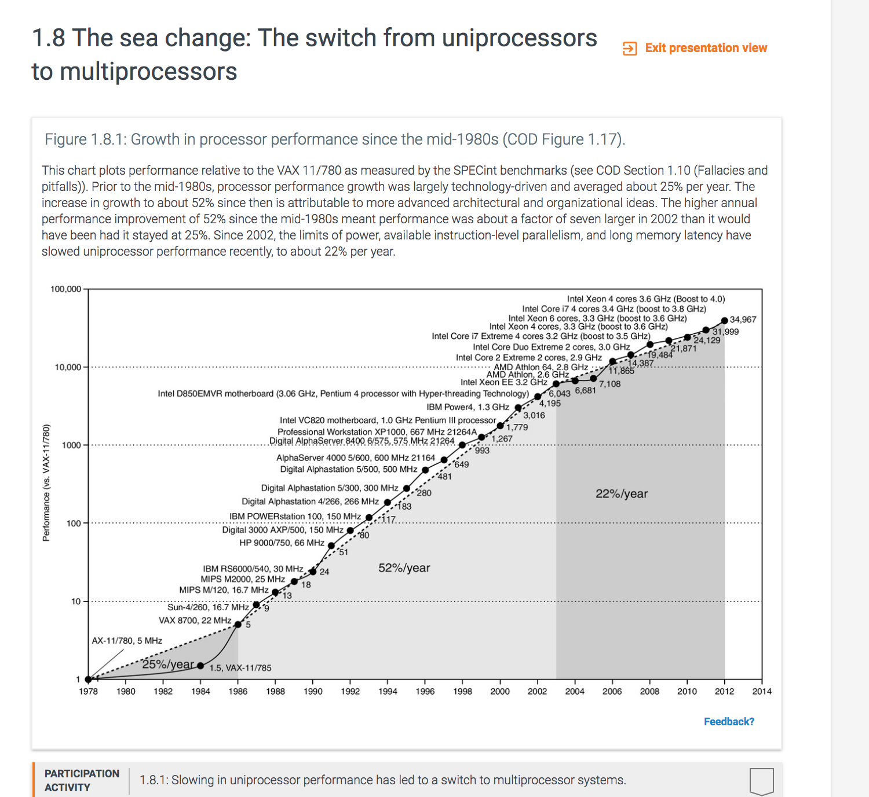
Multiprocessors

Slide 36
Topic 1 - Performance
Why talk about performance first?
Performance is at the heart of every improvement that has been made to computers. Either faster or cheaper.
Talking about performance introduces cycles and instructions which are the basic building blocks of an architecture.
It is a “soft” way of getting started.
We need it for later.
We can calculate something so it makes for good homework.
I have to talk about it.
I will think of others ☺

Slide 37
Performance Evaluation Goals
Buyer perspective
Given a collection of machines, which has the
best performance ?
least cost ?
best cost/performance?
Architect perspective
Faced with design options, which has the
best performance?
least cost ?
best cost/performance?
Both require
Basis for comparison
Metrics for evaluation
Our goal is to understand what factors in the architecture contribute to overall system performance and the relative importance (and cost) of these factors. No absolute answers!!!!
trade-offs
there are many
Notes:
Or smallest/lightest
Longest battery life
Most reliable/durable (in space)

Slide 38
Performance Of What?
Computer
Computer System
Compiler
Operating System
Something else

Slide 39
Numbers are always tricky …
Never let an engineer get away with simply presenting the data. Always insist that he or she lead off with the conclusions to which the data led
Bob Colwell, Pentium Chronicles
Statistics show that of those who contract the habit of eating, very few survive
George Bernard Shaw

Slide 40
Performance Evaluation
What metrics / things to look at?
Execution Time of a task
Throughput
Clock Cycles
CPI - aka clock cycles per instruction
Instruction Count
Computer Architecture
Compiler
Task Characteristics – CPU,IO,Memory
Effective CPI
Bottlenecks
Relative Performance
Compared to what? Another system? A specification? A standard?

Slide 41
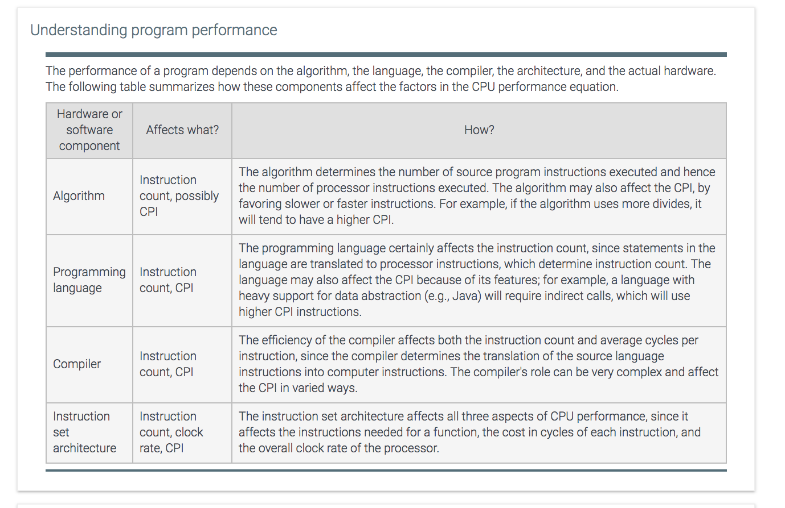
Performance Evaluation

Slide 42
Performance Evaluation
How can we make a meaningful qualitative statement based on quantitative data?

Slide 43
Execution time
Execution time:
the time between the start and the completion of a task
Typically, “task” is a program
For personal computers it may mean
boot time
launch time
Important to individual users
Also called
Response Time (often in the context of real-time systems)
Wall Clock Time

Slide 44
Throughput
Throughput
# of tasks per unit time
total amount of work done in a given time
sometimes called bandwidth – not by me
Throughput = # of processes completed / time
Throughput = # of pages served / time
Important when evaluating
data centers
web servers
operating systems
Decreasing execution time almost always improves throughput

Slide 45
BIG Picture
CPU spends time on various things, not just our single task. User experiences elapsed time of program running, not cpu time!
We are going to focus on our tasks cpu time.
Notes:
Seconds per program equals instructions per program time clock cycles per instruction times seconds per clock cycle

Slide 46
Clock Cycles
Every computer has a clock that ticks
Length of a clock tick is referred to as a clock cycle
Clock cycle is the minimum unit of time that the system can measure
Also the unit of time when an event can occur
Clock cycle on modern machines measured in picoseconds (10⁻¹²) ( 1 TeraHertz)
The smaller the clock cycle, the faster the machine
one clock period
Notes:
A clock cycle is the basic unit of time to execute one operation/pipeline stage/etc.

Slide 47
Clock Rate
Number of ticks per second
measured in GHz (or formerly MHz)
advertised processor speed
computed as the inverse of clock cycle
Clock Rate = 1 / Clock Cycle (in seconds)
Examples:
10 nanosec clock cycle => 1/10 x 10⁻⁹ = 1/10⁻⁸ = 10⁸ = 100 MHz clock rate
1 nanosec (10⁻⁹) clock cycle => 1 GHz (10⁹) clock rate
500 psec clock cycle => 2 GHz clock rate
250 psec clock cycle => 4 GHz clock rate
200 psec clock cycle => 5 GHz clock rate
Notes:
Clock Rate is inverse of clock cycle time

Slide 48
CPU Execution Time
# of clock cycles = # of cycles program is busy doing work on the CPU
Can improve performance by
Reducing either the length of the clock cycle
comes from Moore’s Law (technology)
Reducing number of clock cycles required for a program
Architecture
Compiler
OS
Notes:
Equation on page - cpu execution time is equal to the number of cpu clock cycles for a program divided by the clock rate of the processor seconds equal cycles divided by cycles per second

